Slide 1
Lecture 5 Relations ENSIA 2023-2024

Slide 2
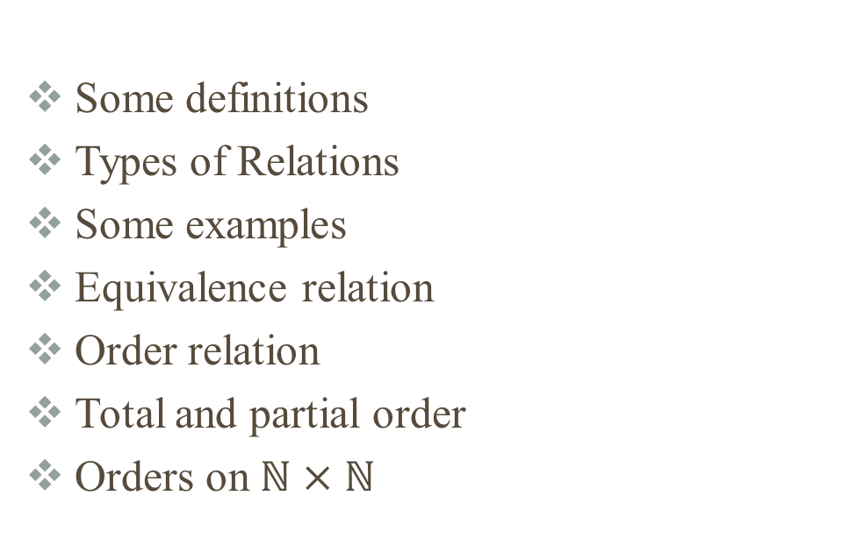
Summary
Some definitions
Types of Relations
Some examples
Equivalence relation
Order relation
Total and partial order
Orders on $ℕ×$ $ℕ$

Slide 3
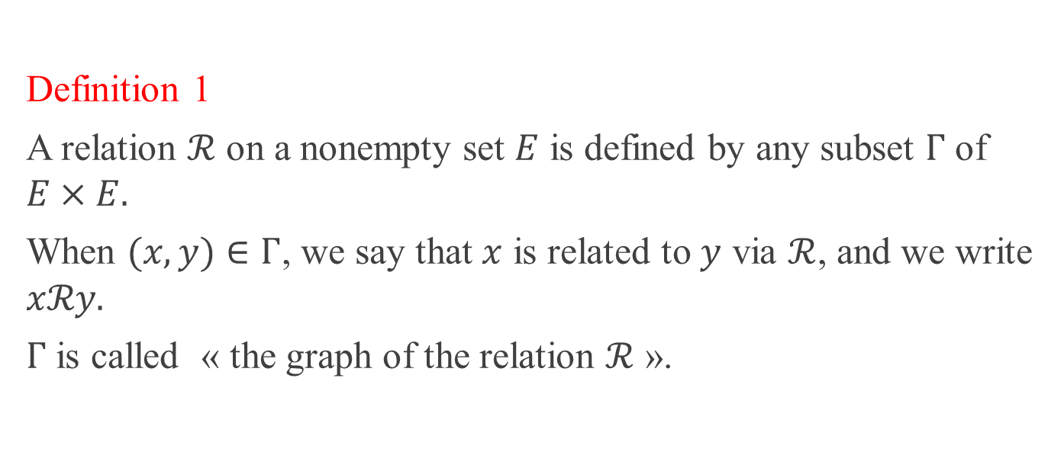
Definition
Definition 1
A relation $ℛ$ on a nonempty set $E$ is defined by any subset $Γ$ of $E×E.$
When $(x,y)∈Γ$, we say that $x$ is related to $y$ via $ℛ$, and we write $xℛy.$
$Γ$ is called « the graph of the relation $ℛ$ ».

Slide 4
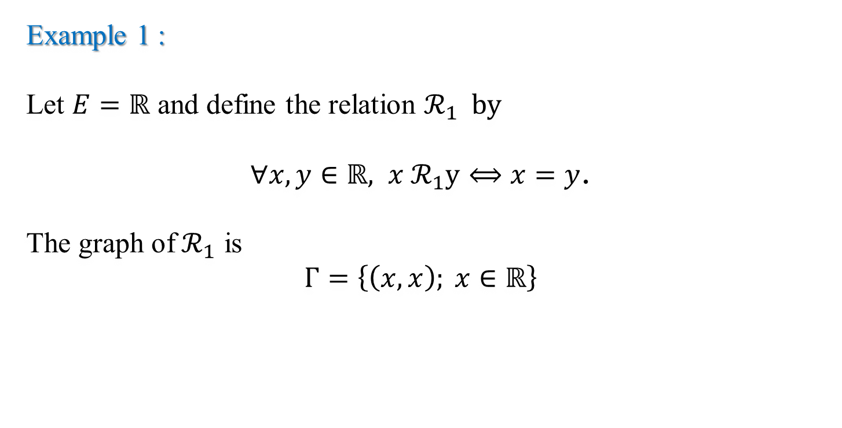
Examples
Example 1 :
Let $E=ℝ$ and define the relation $ℛ_{1} by$
$∀x,y∈ℝ, x{ ℛ}_{1}y⟺x=y$.
The graph of${ ℛ}_{1}$ is
$Γ=\left\{\left(x,x\right); x∈ℝ\right\}$

Slide 5
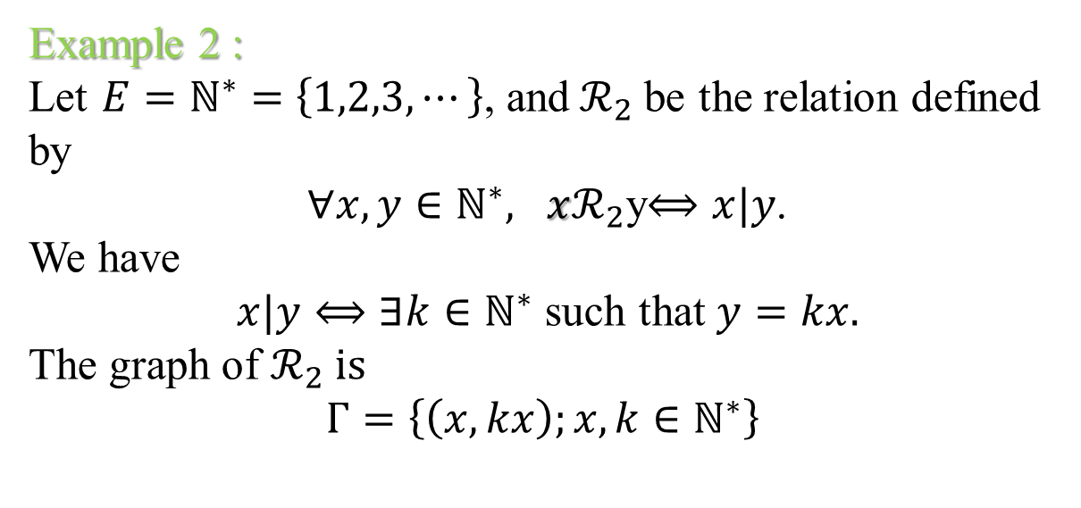
Examples
Example 2 :
Let $E=ℕ^{∗}=$ $\left\{1,2,3, ⋯\right\}$, and${ ℛ}_{2}$be the relation defined by
$∀x,y∈ℕ^{∗}, xℛ_{2}$y$⟺x|y$.
We have
$x|y⟺∃k∈ℕ^{∗}$ such that $y=kx.$
The graph of $ℛ_{2} is$
$Γ=\left\{\left(x,kx\right);x,k∈ℕ^{∗}\right\}$

Slide 6

Types of relations
Let $ℛ$ be a relation on a the nonempty set $E$.
Definition 2
We say that $ℛ$ is reflexive if
$∀x∈E, xℛx$.

Slide 7

Types of relations
Definition 3
We say that $ℛ$ is symmetric if
$∀x,y∈E, xℛy$ $⟹yℛx.$

Slide 8
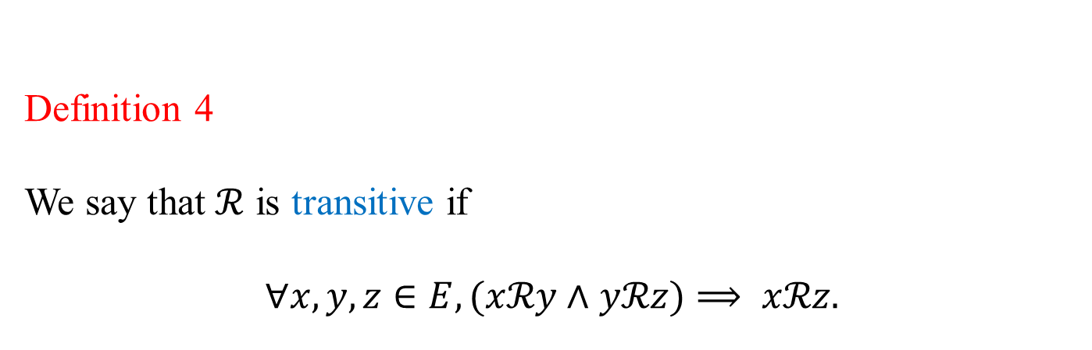
Types of relations
Definition 4
We say that $ℛ$ is transitive if
$∀x,y,z∈E, (xℛy$ $∧$ $yℛz)⟹ xℛz.$

Slide 9
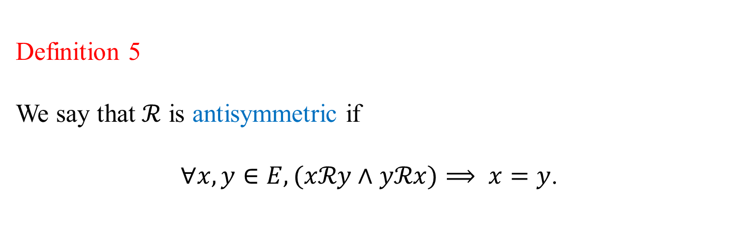
Types of relations
Definition 5
We say that $ℛ$ is antisymmetric if
$∀x,y∈E, (xℛy$ $∧$ $yℛx)⟹ x=y$.
Notes:
.

Slide 10

Examples
The relation $ℛ_{1}$in example 1, defined by
$$∀x,y∈ℝ, x{ ℛ}_{1}y⟺x=y,$$
is
reflexive,
symmetric,
transitive,
antisymmetric.

Slide 11
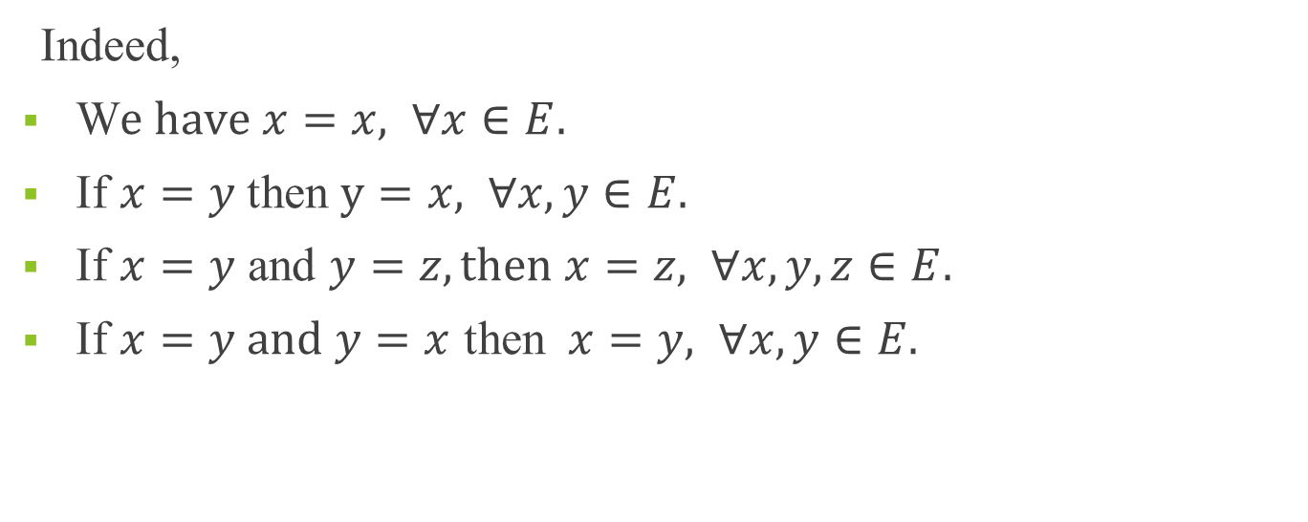
Examples
Indeed,
W$e have x=x, ∀x∈E.$
If $x=y$then $y=x, ∀x,y∈E.$
If $x=y$ and $y=z, then$ $x=z, ∀x,y,z∈E.$
If $x=y and$ $y=x$ then $x=y, ∀x,y∈E.$
Notes:
y.

Slide 12

Examples
The relation $ℛ_{2}$, defined in example 2 by
$∀x,y∈ℕ^{∗}, xℛ_{2}$y$⟺x|y$.
is
reflexive,
Transitive,
antisymmetric.

Slide 13
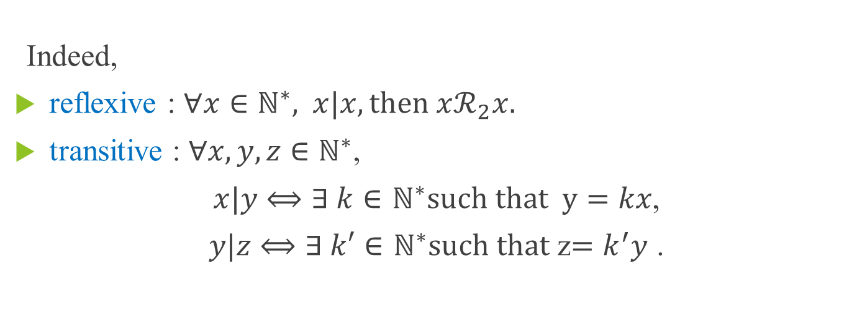
Examples
Indeed,
reflexive : $∀x∈ℕ^{∗},$ $x|x, then$ $xℛ_{2}x.$
transitive : $∀x,y,z∈ℕ^{∗}$,
$x|y$ $⟺∃ k∈$ $ℕ^{∗}such that y=kx$,
$y|z$ $⟺∃ k′∈$ $ℕ^{∗}such that$ z$=k^{′}y$ .

Slide 14

Examples
We have then
$$z=k^{′}kx.$$
Setting $k^{′′}=k^{′}k,$ we have $z=k^{′′}x,$ where $k′′∈ℕ^{∗}\text{.}$
Therefore $x$ $ℛ_{2}$ $z.$
Notes:
.

Slide 15

Examples
Antisymmetric :
$∀x,y∈ℕ^{∗}$,
$x|y$ $⟺∃ k∈$ $ℕ^{∗}$ such that $y=kx$,
$y|x$ $⟺∃ k′∈$ $ℕ^{∗}$ such that $x=k^{′}y.$

Slide 16
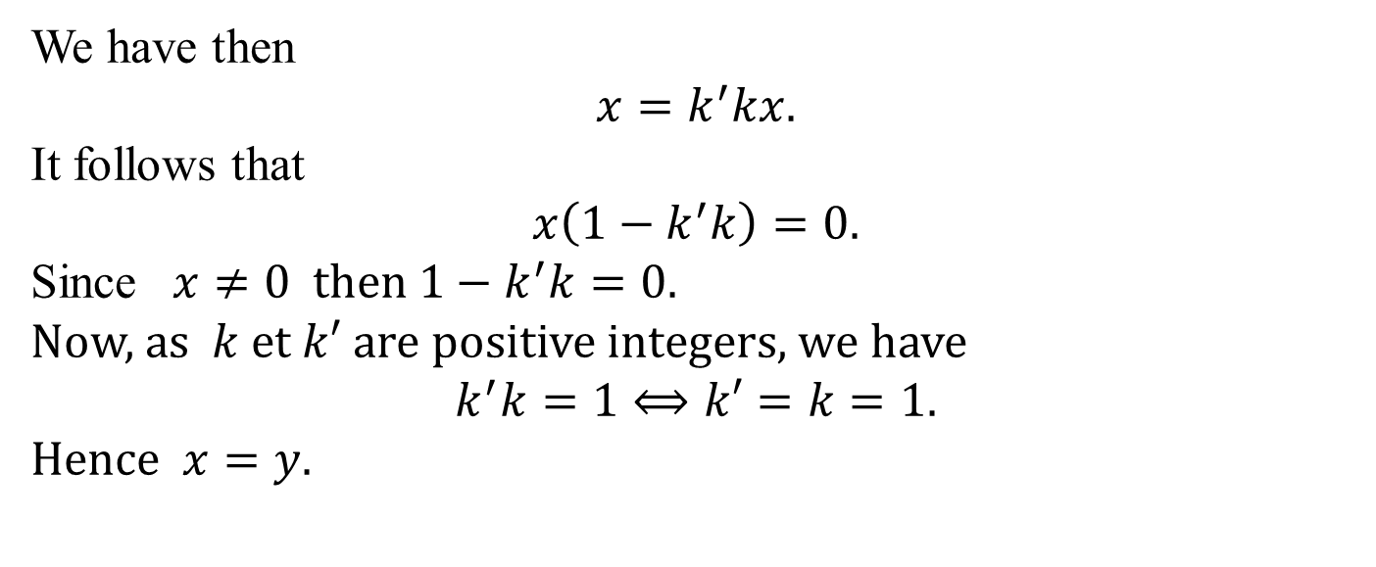
Examples
We have then
$$x=k^{′}kx.$$
It follows that
$$x\left(1−k^{′}k\right)=0.$$
Since $x≠0$ then $1−k^{′}k=0.$
Now, as $k$ et $k′$ are positive integers, we have
$$k^{′}k=1⟺k′=k=1.$$
Hence $x=y.$

Slide 17

Examples
We show now that the relation $ℛ_{2}$ is not symmetric.
We have
$ℛ_{2}$is symmetric $⟺∀x,y∈$ $ℕ^{∗},$ $x|y⟹y|$x,

Slide 18

Examples
Then
$ℛ_{2}$ is not symmetric
$$⟺$$
$∃x,y∈ℕ^{∗}$ : $x$ $ℛ_{2} y$ and $¬(yℛ_{2}$x).

Slide 19
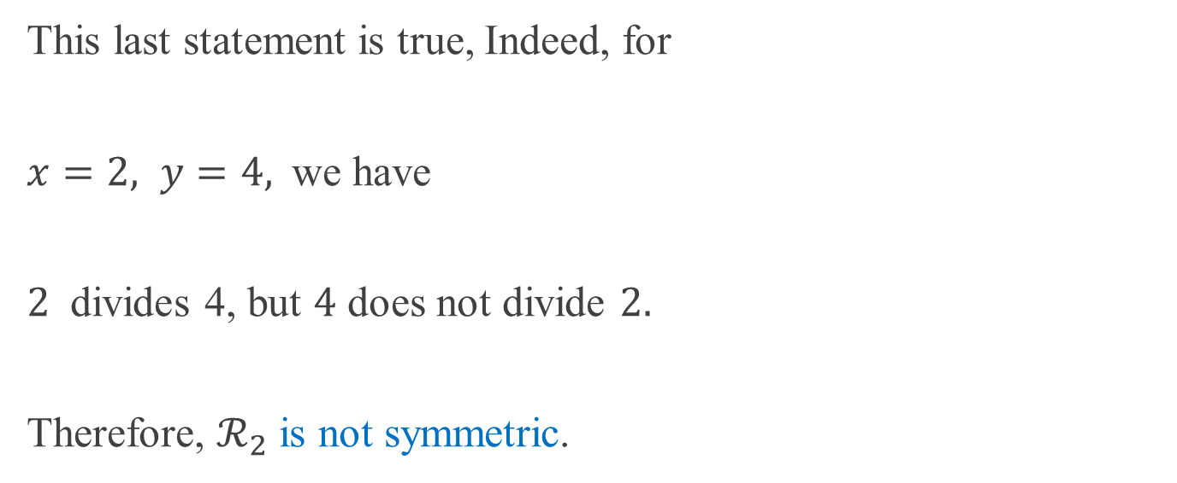
Examples
This last statement is true, Indeed, for
$x=2, y=4,$ we have
$2$ divides 4, but $4$ does not divide $2.$
Therefore, $ℛ_{2}$ is not symmetric.

Slide 20
Examples
Warning !
The notions of symmetric and antisymmetric are not opposite.

Slide 21
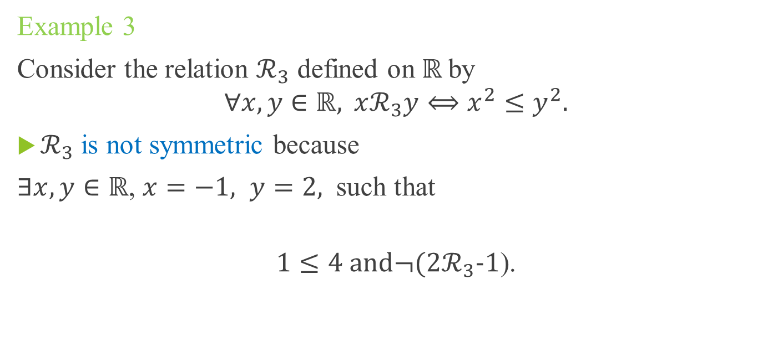
Examples
Example 3
Consider the relation $ℛ_{3}$ defined on $ℝ$by
$$∀x,y∈ℝ, xℛ_{3}y⟺x^{2}≤y^{2}.$$
$ℛ_{3}$ is not symmetric because
$∃x,y∈ℝ$, $x=−1, y=2,$ such that
$$1≤4 and¬(2ℛ_{3}\text{−1}\text{).}$$
Notes:
.

Slide 22

Examples
$ℛ_{3}$ is not antisymmetric. Indeed,
$∃x,y∈ℝ$, $x=−2, y=2, such that$
${xℛ}_{3}y$ since $4≤4$
and
${yℛ}_{3}x$ since $4≤4$,
and we have $−2≠2.$

Slide 23
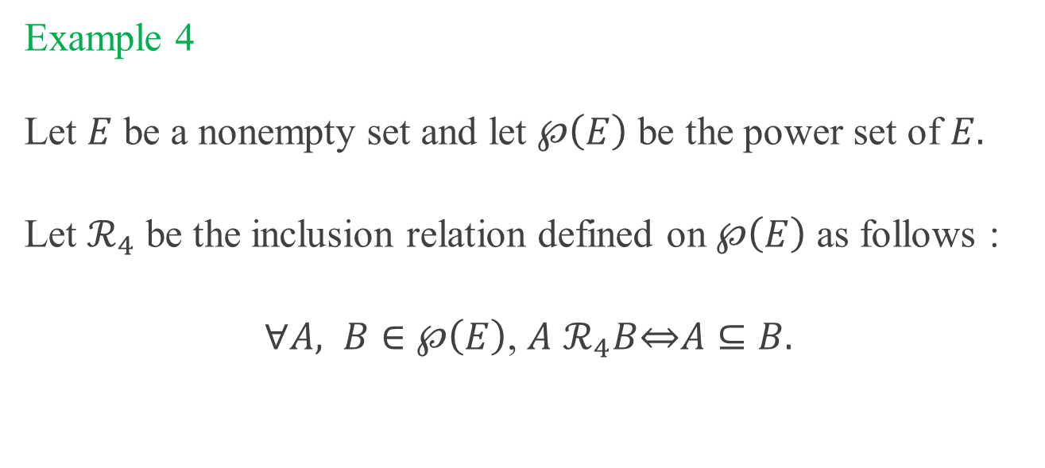
Examples
Example 4
Let $E$ be a nonempty set and let $℘\left(E\right)$ be the power set of $E.$
Let $ℛ_{4}$ be the inclusion relation defined on $℘\left(E\right)$ as follows :
$∀A, B∈℘\left(E\right)$, $A$ $ℛ_{4}B\underset{⇔}{ }A⊆B.$

Slide 24

Examples
$ℛ_{4}$ is reflexive since
$∀A∈$ $℘\left(E\right)$, $A⊆A.$

Slide 25
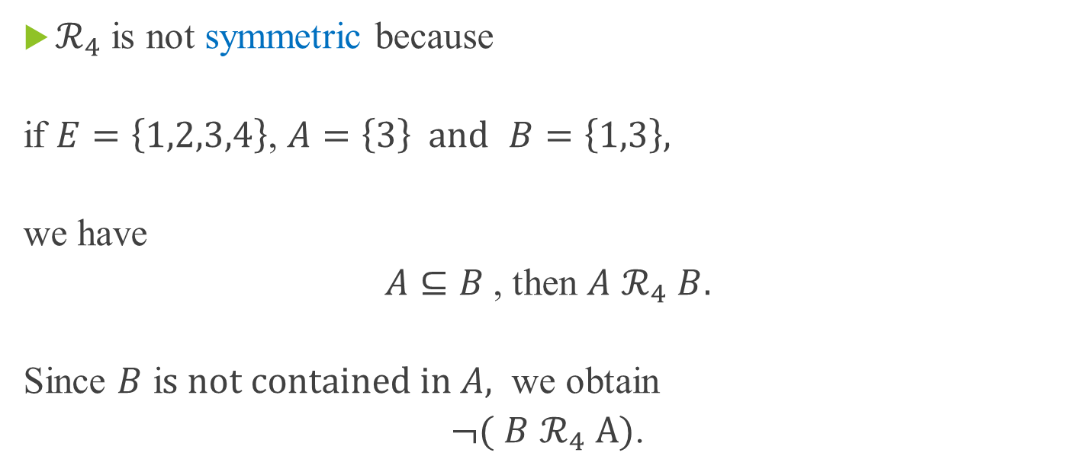
Examples
$ℛ_{4}$ is not symmetric because
if $E=\left\{1,2,3,4\right\}$, $A=\left\{3\right\} and$ $B=\left\{1,3\right\},$
we have
$A⊆B$, then $A$ $ℛ_{4}$ $B.$
Since $B$ i$s not contained in A,$ we obtain
$¬($ $B$ $ℛ_{4}$ $A)$.

Slide 26
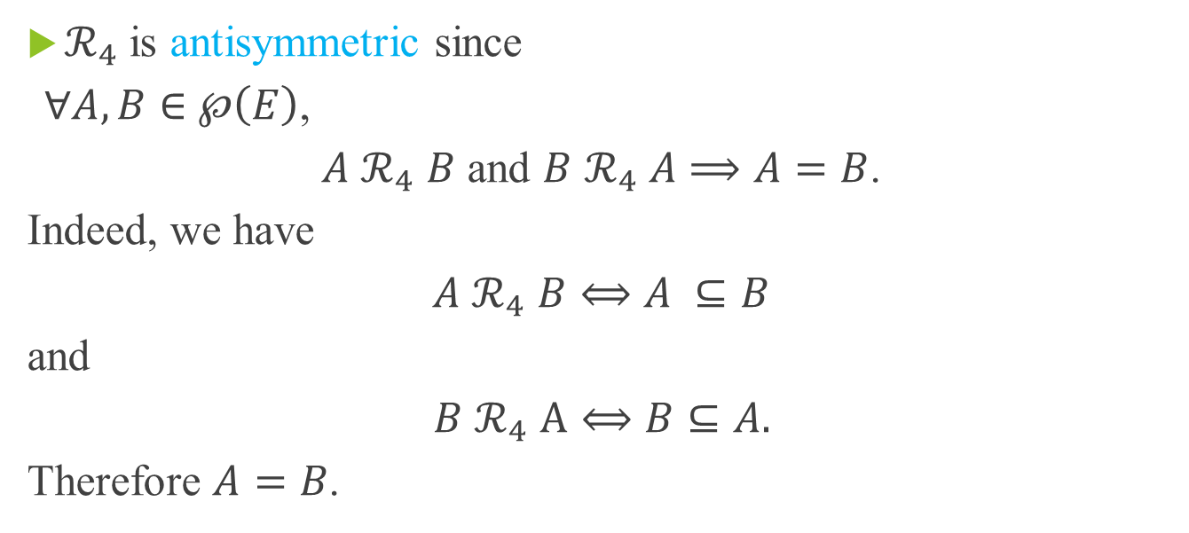
Examples
$ℛ_{4}$ is antisymmetric since
$∀A,B∈$ $℘\left(E\right)$,
$A$ $ℛ_{4}$ $B$ and $B$ $ℛ_{4}$ $A$ $⟹A=B$.
Indeed, we have
$A$ $ℛ_{4}$ $B⟺A ⊆B$
and
$B$ $ℛ_{4}$ $A⟺B⊆A.$
Therefore $A=B$.

Slide 27

Examples
$ℛ_{4}$ is transitive since
$∀A,B,C∈℘\left(E\right)$,
if $A⊆B$ and $B⊆C$, then $A⊆C$.

Slide 28
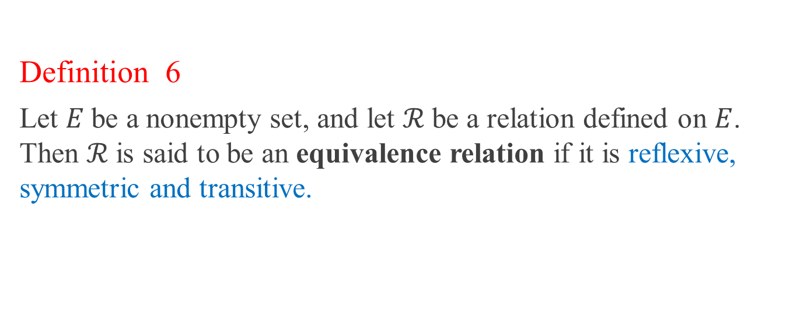
Equivalence relation
Definition 6
Let $E$be a nonempty set, and let $ℛ$be a relation defined on $E$. Then $ℛ$is said to be an equivalence relation if it is reflexive, symmetric and transitive.
Notes:
.

Slide 29
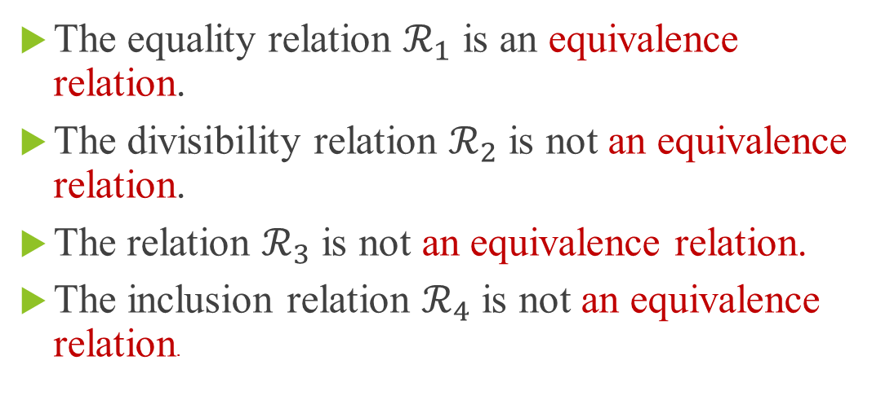
Examples
The equality relation $ℛ_{1}$ is an equivalence relation.
The divisibility relation $ℛ_{2}$ is not an equivalence relation.
The relation $ℛ_{3}$ is not an equivalence relation.
The inclusion relation $ℛ_{4}$ is not an equivalence relation.

Slide 30
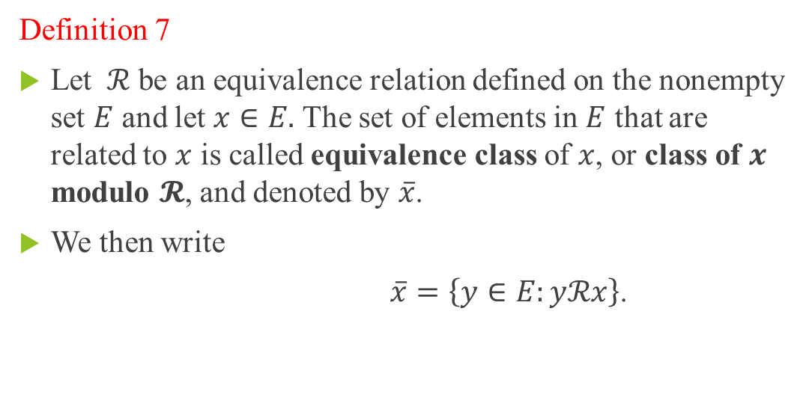
Equivalence class
Definition 7
Let $ℛ$ be an equivalence relation defined on the nonempty set $E$ and let $x∈E.$ The set of elements in $E$ that are related to $x$ is called equivalence class of $x$, or class of $x$ modulo $𝓡$, and denoted by $\overline{x}$.
We then write
$\overline{x}=\left\{y∈E:yℛx\right\}$.

Slide 31
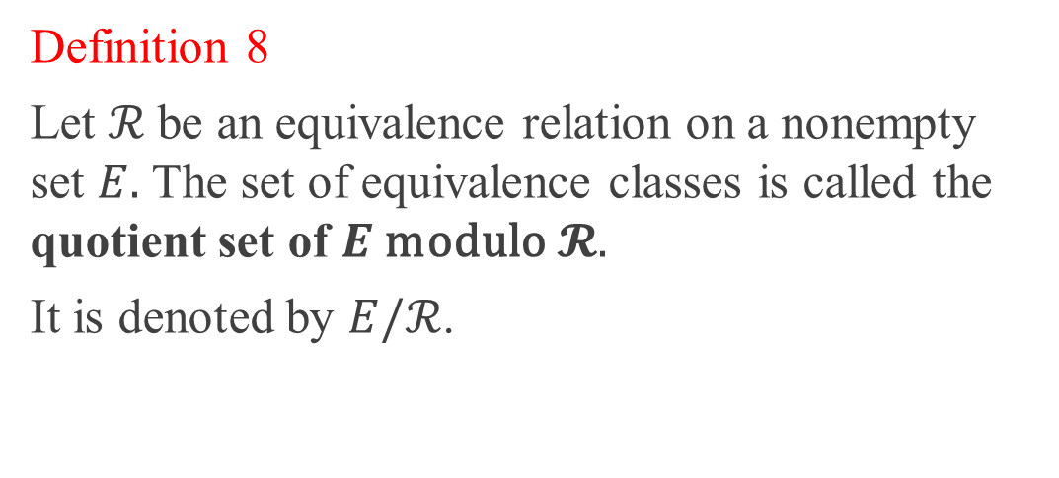
Quotient set
Definition 8
Let $ℛ$be an equivalence relation on a nonempty set $E.$ The set of equivalence classes is called the quotient set of $E$modulo$𝓡.$
It is denoted by $E/ℛ$.

Slide 32
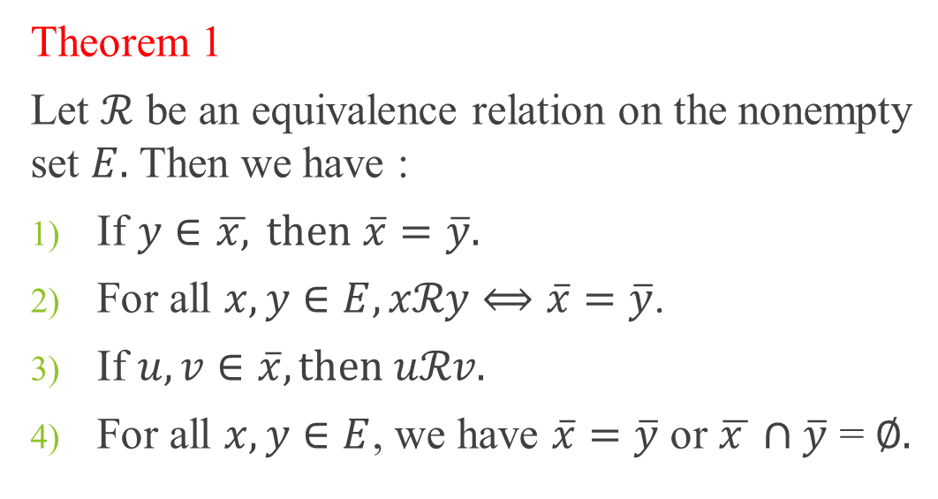
Fundamental properties
Theorem 1
Let $ℛ$ be an equivalence relation on the nonempty set $E.$ Then we have :
If $y∈$ $\overline{x,} then$ $\overline{x}=\overline{y}.$
For all $x, y∈E, xℛy⟺\overline{x}=\overline{y}$.
If $u, v∈\overline{x}, then uℛv.$
For all $x, y∈E$, we have $\overline{x}=\overline{y}$ or $\overline{x }∩\overline{y}$ = $∅.$

Slide 33
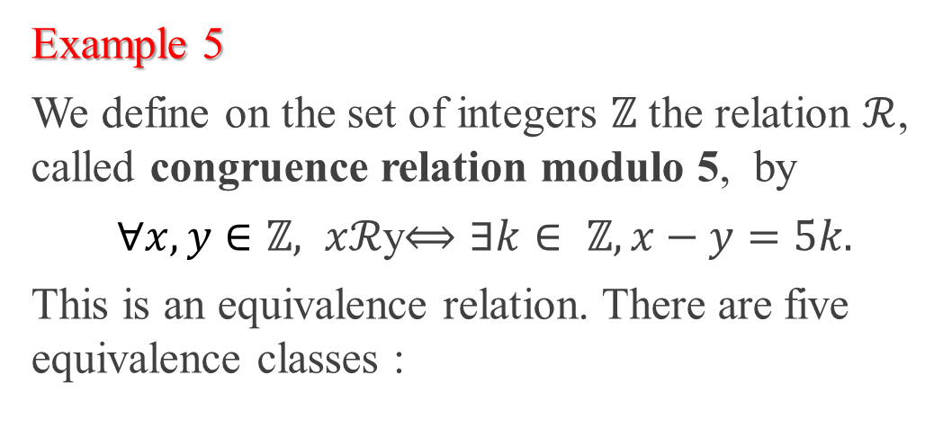

The quotient set $ℤ$/5$ℤ$
Example 5
We define on the set of integers $ℤ$ the relation $ℛ$, called congruence relation modulo 5, by
$∀x, y∈ℤ, xℛ$y$⟺∃k∈ ℤ,x−y=5k.$
This is an equivalence relation. There are five equivalence classes :

Slide 34
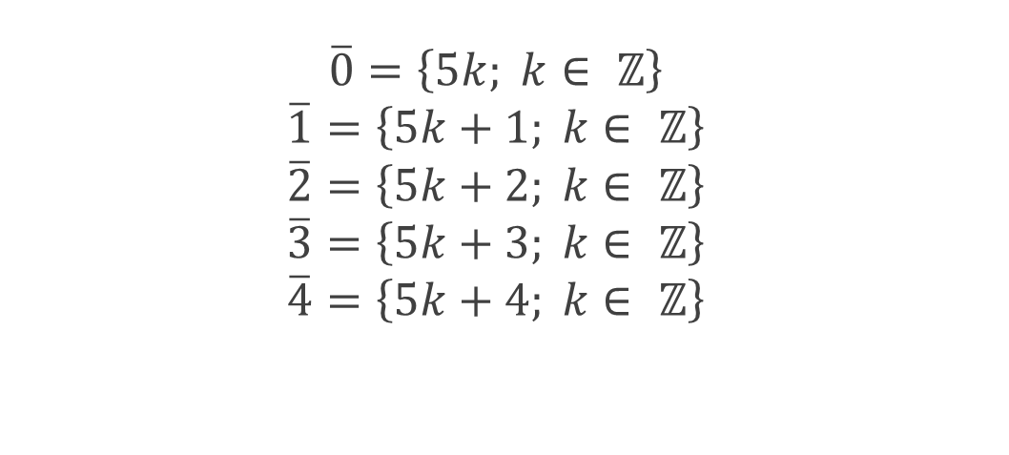

The quotient set$ℤ$/5$ℤ$
$$\overline{0}=\left\{5k; k∈ ℤ\right\}$$
$$\overline{1}=\left\{5k+1; k∈ ℤ\right\}$$
$$\overline{2}=\left\{5k+2; k∈ ℤ\right\}$$
$$\overline{3}=\left\{5k+3; k∈ ℤ\right\}$$
$$\overline{4}=\left\{5k+4; k∈ ℤ\right\}$$

Slide 35
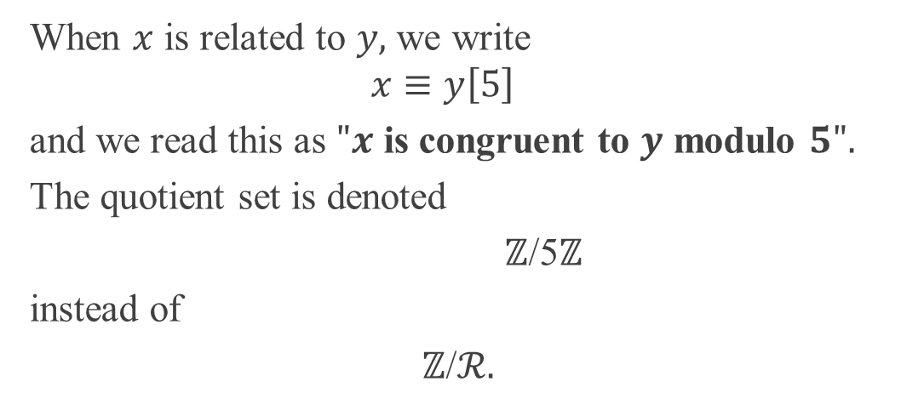

The quotient set $ℤ$/5$ℤ$
When $x$ is related to $y,$ we write
$$x≡y\left[5\right]$$
and we read this as $"x$ is congruent to $y$ modulo $5".$
The quotient set is denoted
$ℤ$/5$ℤ$
instead of
$ℤ$/$ℛ.$

Slide 36
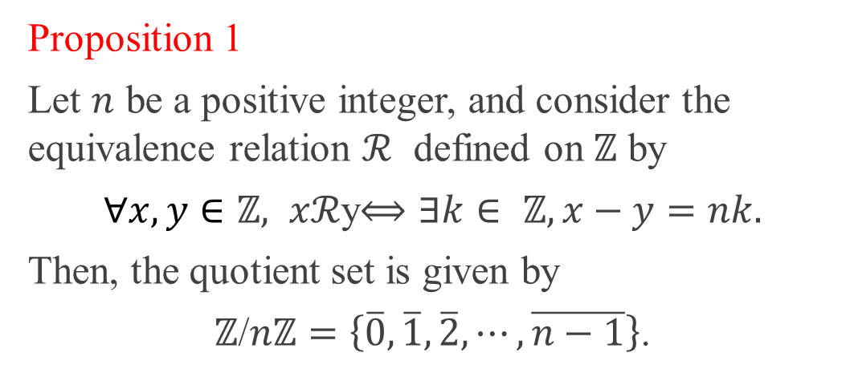

The quotient set $ℤ$/$nℤ$
Proposition 1
Let $n$ be a positive integer, and consider the equivalence relation $ℛ$ defined on $ℤ$ by
$∀x, y∈ℤ, xℛ$y$⟺∃k∈ ℤ,x−y=nk.$
Then, the quotient set is given by
$ℤ$/$nℤ=\left\{\overline{0},\overline{1}, \overline{2}, ⋯, \overline{n−1}\right\}$.

Slide 37
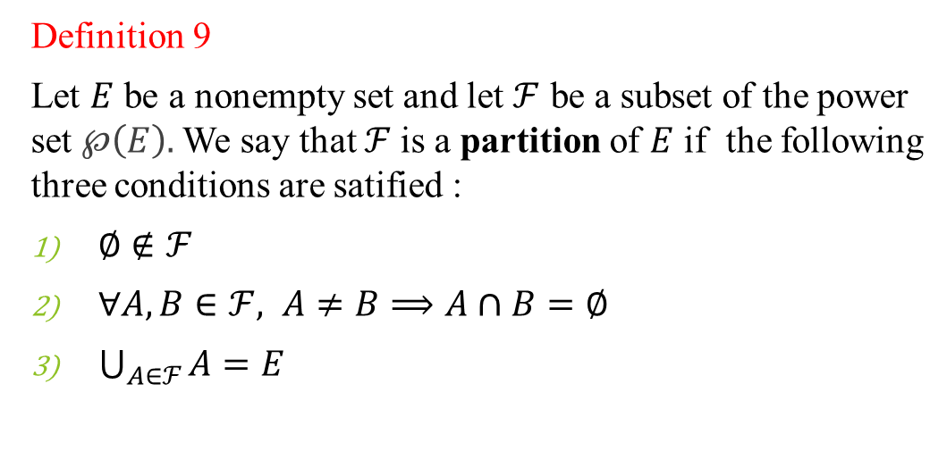
Partition of a set
Definition 9
Let $E$ be a nonempty set and let $ℱ$ be a subset of the power set $℘\left(E\right).$ We say that $ℱ$is a partition of $E$ if the following three conditions are satified :
$∅∉ℱ$
$∀A, B∈ℱ, A≠B⟹A∩B=∅$
$\bigcup_{A∈ℱ}{A=E}$

Slide 38
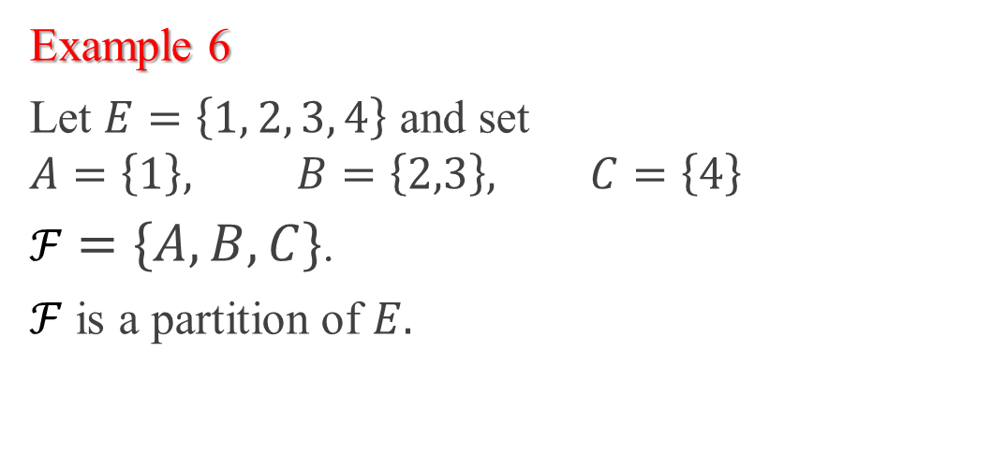
Example
Example 6
Let $E=\left\{1, 2, 3, 4\right\}$ and set
$$A=\left\{1\right\}, B=\left\{2,3\right\}, C=\left\{4\right\}$$
$ℱ=\left\{A,B, C\right\}$.
$ℱ$ is a partition of $E.$

Slide 39
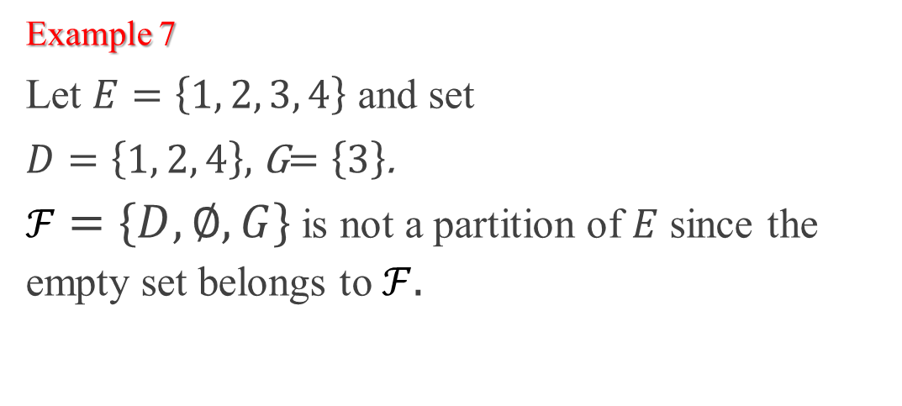
Example
Example 7
Let $E=\left\{1, 2, 3, 4\right\}$ and set
$D=\left\{1, 2, 4\right\},$ G$=\left\{3\right\}$.
$ℱ=\left\{D, ∅, G\right\}$ is not a partition of $E$ since the empty set belongs to $ℱ.$

Slide 40
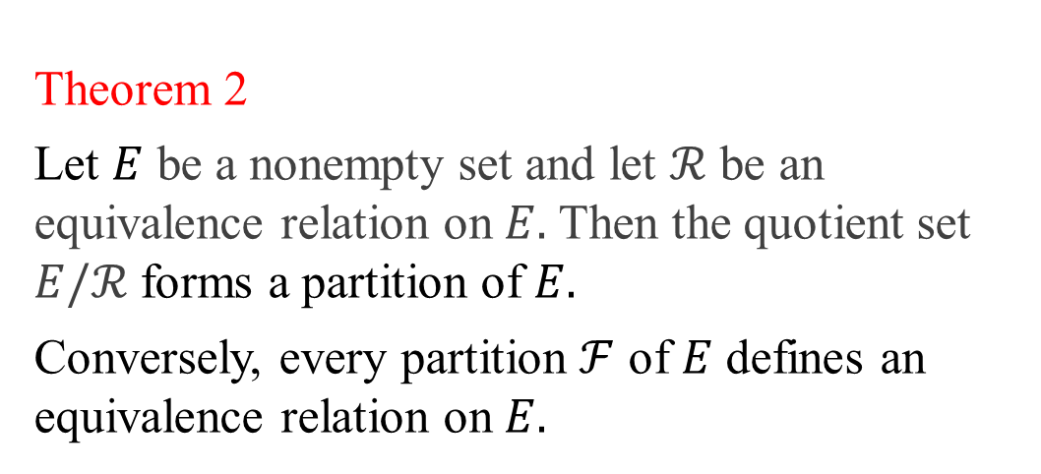
Equivalence classes and partition
Theorem 2
Let $E$ be a nonempty set and let $ℛ$ be an equivalence relation on $E.$ Then the quotient set $E/ℛ$ forms a partition of $E.$
Conversely, every partition $ℱ$ of $E$ defines an equivalence relation on $E.$

Slide 41
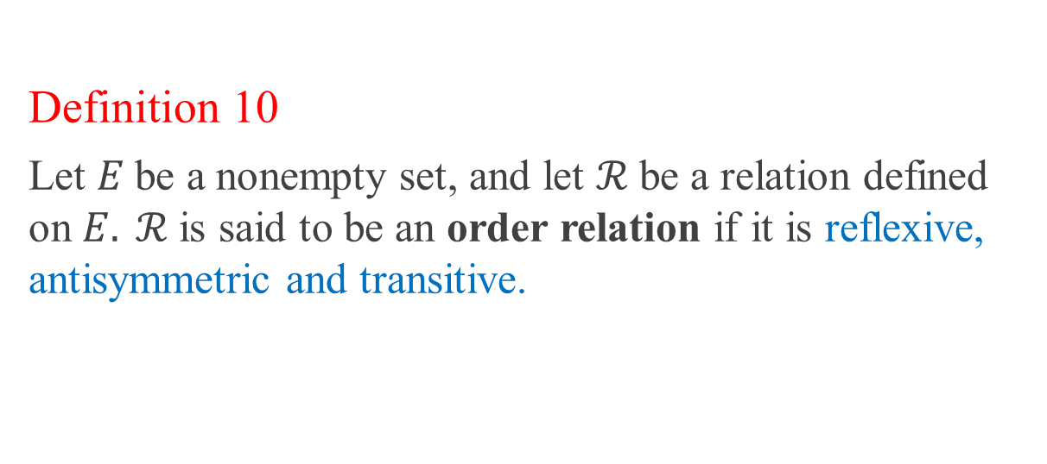
Order Relation
Definition 10
Let $E$be a nonempty set, and let $ℛ$be a relation defined on $E. ℛ$is said to be an order relation if it is reflexive, antisymmetric and transitive.

Slide 42
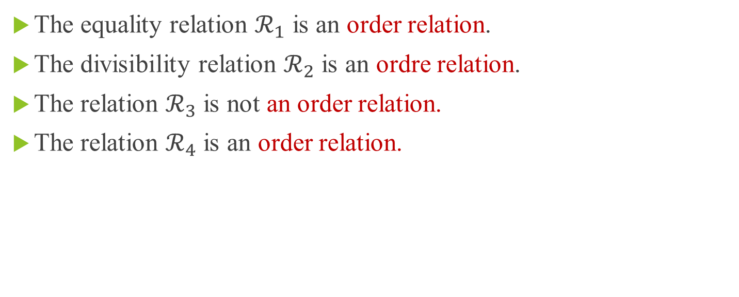
Examples
The equality relation $ℛ_{1}$ is an order relation.
The divisibility relation $ℛ_{2}$ is an ordre relation.
The relation $ℛ_{3}$ is not an order relation.
The relation $ℛ_{4}$ is an order relation.

Slide 43
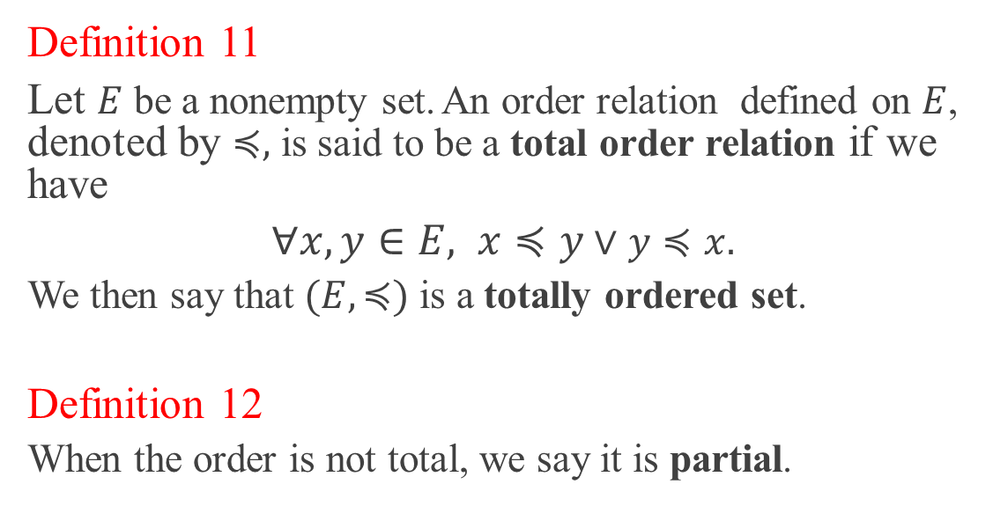
Partial and total order
Definition 11
Let $E$ be a nonempty set. An order relation defined on $E$, denoted by $≼,$ is said to be a total order relation if we have
$∀x,y∈E, x≼y$ $∨$ $y≼x.$
We then say that $(E, ≼)$ is a totally ordered set.
Definition 12
When the order is not total, we say it is partial.

Slide 44
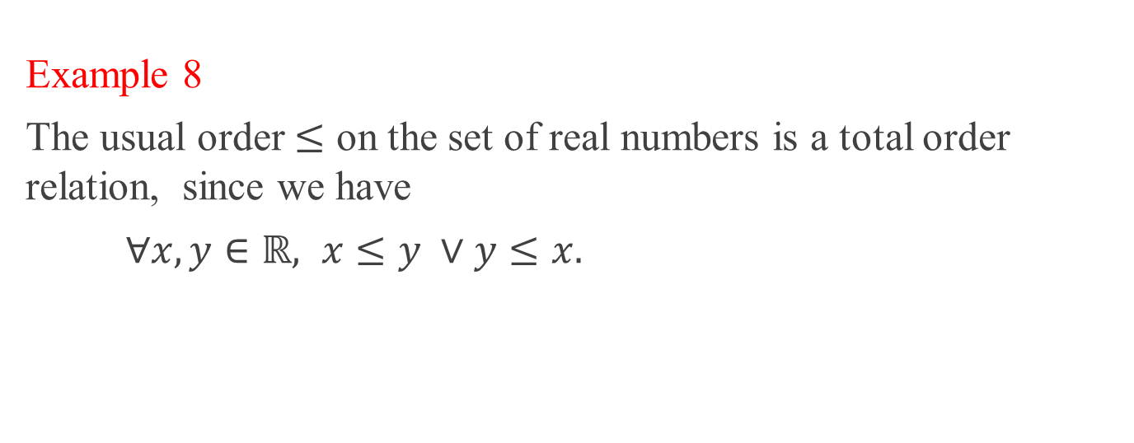
Examples
Example 8
The usual order $≤$ on the set of real numbers is a total order relation, since we have
$∀x,y∈ℝ, x≤y ∨$ $y≤x.$

Slide 45
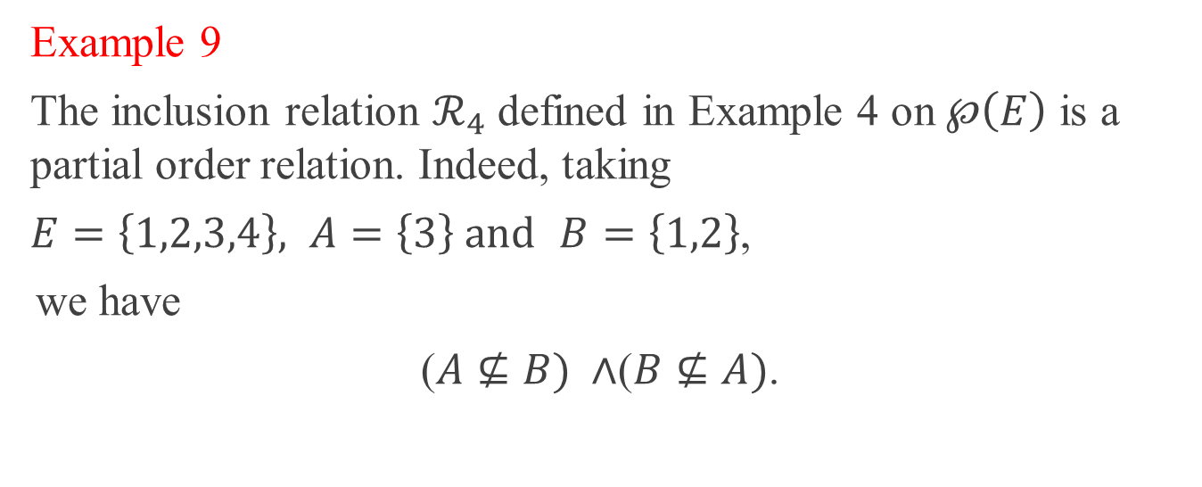
Examples
Example 9
The inclusion relation $ℛ_{4}$ defined in Example 4 on $℘\left(E\right)$ is a partial order relation. Indeed, taking
$E=\left\{1,2,3,4\right\}, A=\left\{3\right\} and$ $B=\left\{1,2\right\}$,
we have
($A⊈B) ∧$($B⊈A)$.

Slide 46
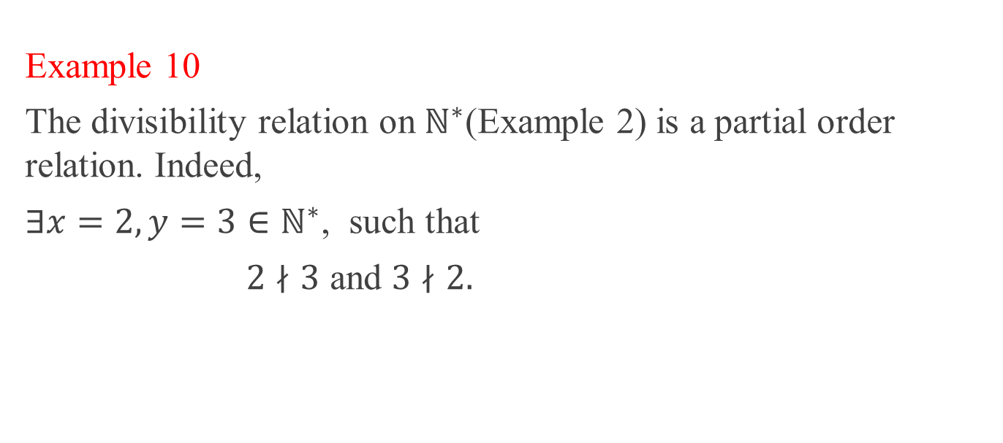
Examples
Example 10
The divisibility relation on $ℕ^{∗}$(Example 2) is a partial order relation. Indeed,
$∃x=2,y=3∈ℕ^{∗}$, such that
$2∤3$ and $3∤2.$

Slide 47
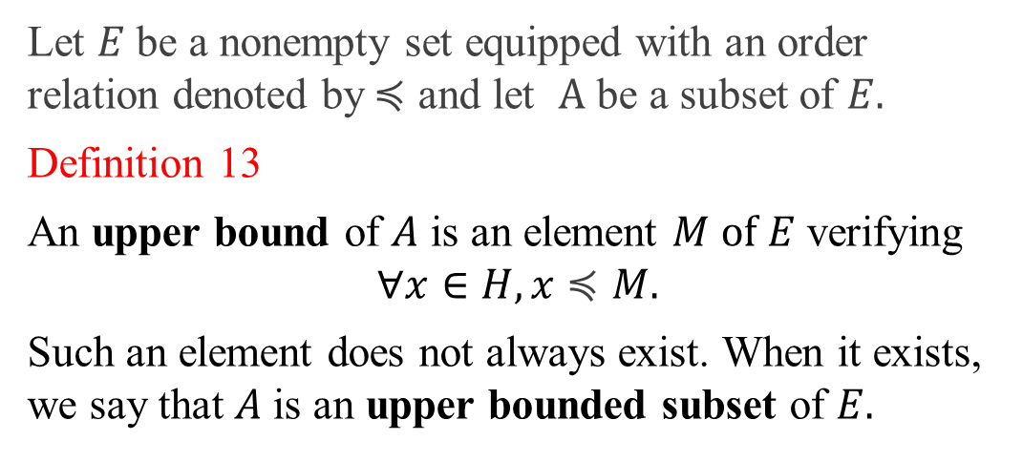
Special elements
Let $E$ be a nonempty set equipped with an order relation denoted by$≼$ and let $A$ be a subset of $E.$
Definition 13
An upper bound of $A$ is an element $M of$ $E$ verifying
$$∀x∈H, x≼M.$$
Such an element does not always exist. When it exists, we say that $A$is an upper bounded subset of $E.$

Slide 48
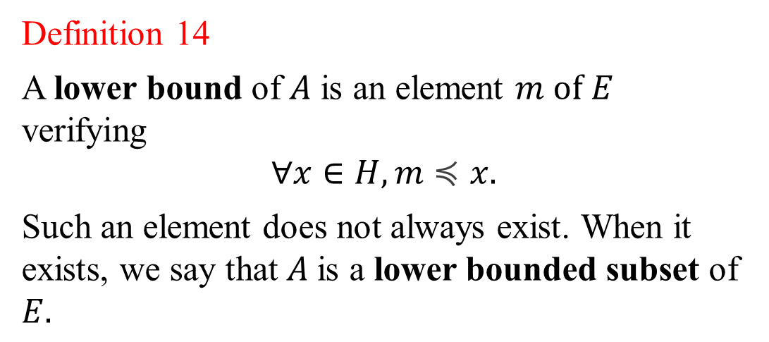
Special elements
Definition 14
A lower bound of $A$ is an element $m of$ $E$ verifying
$$∀x∈H, m≼x.$$
Such an element does not always exist. When it exists, we say that $A$is a lower bounded subset of $E.$

Slide 49
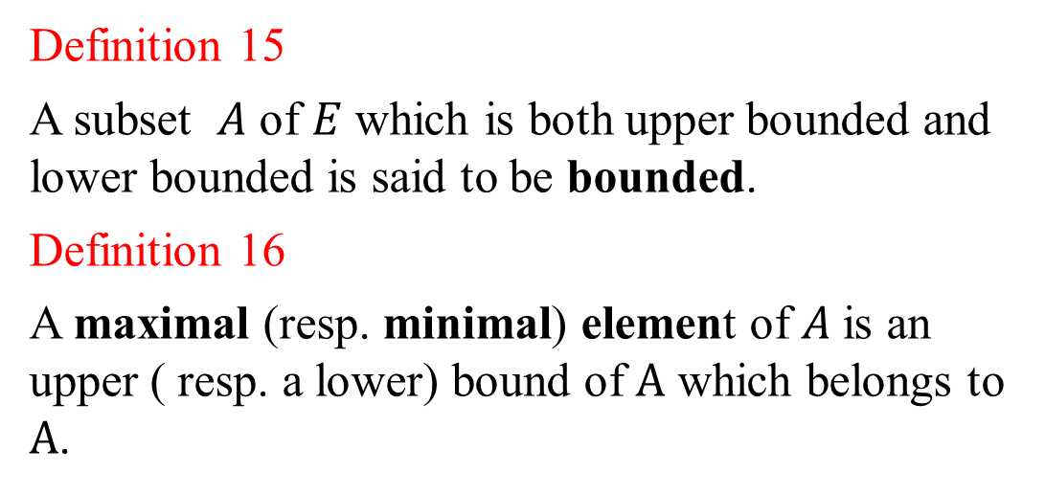
Special elements
Definition 15
A subset $A$ of $E$ which is both upper bounded and lower bounded is said to be bounded.
Definition 16
A maximal (resp. minimal) element of $A$is an upper ( resp. a lower) bound of $A$ which belongs to $A$.

Slide 50
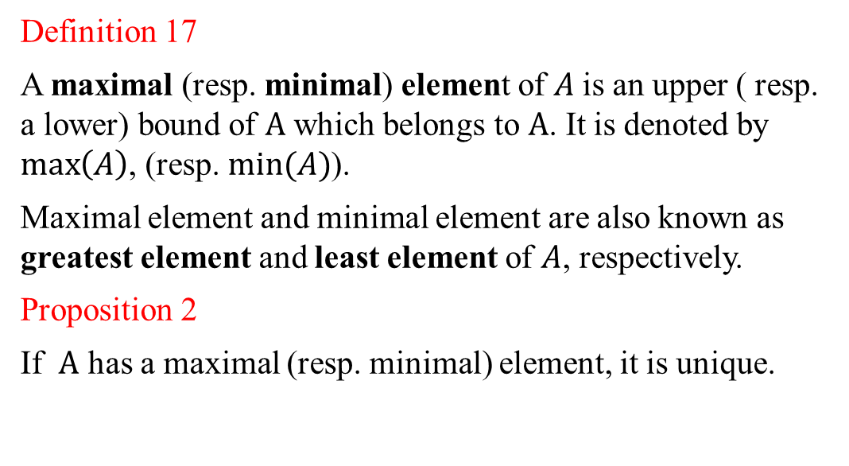
Special elements
Definition 17
A maximal (resp. minimal) element of $A$is an upper ( resp. a lower) bound of $A$ which belongs to $A$. It is denoted by $\max\left(A\right)$, (resp. $min⁡(A)$).
Maximal element and minimal element are also known as greatest element and least element of $A$, respectively.
Proposition 2
If $A$ has a maximal (resp. minimal) element, it is unique.

Slide 51
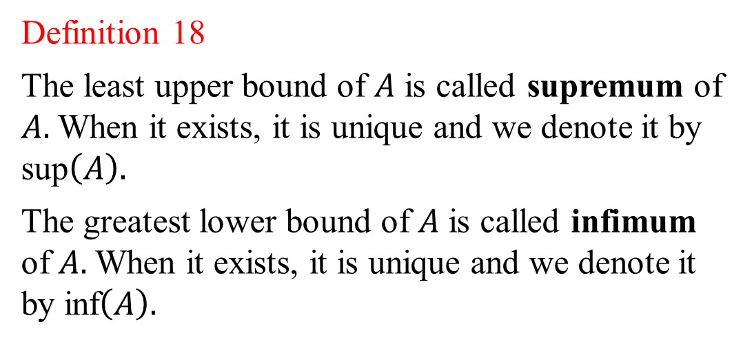
Special elements
Definition 18
The least upper bound of $A$ is called supremum of $A.$When it exists, it is unique and we denote it by sup$\left(A\right).$
The greatest lower bound of $A$ is called infimum of $A.$When it exists, it is unique and we denote it by inf$\left(A\right).$

Slide 52
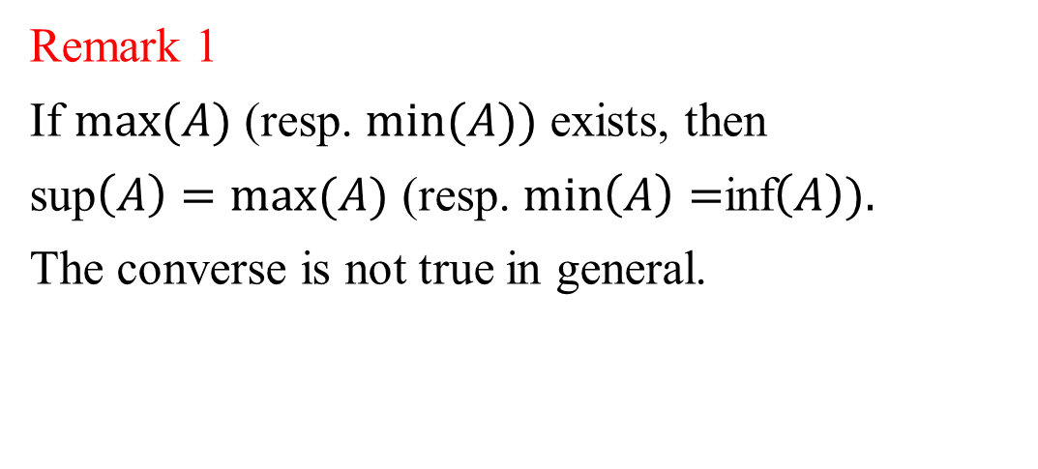
Special elements
Remark 1
If $max⁡(A)$ (resp. $min⁡(A))$ exists, then
sup$\left(A\right)=max⁡(A)$ (resp. $\min\left(A\right)=$inf$\left(A\right)).$
The converse is not true in general.

Slide 53

Example
Example 5
Consider the set of real numbers $ℝ$equipped with the usual order relation $≤$ and set $A=[a,b[, where$ $a<b.$
The set of upper bounds of $A$ belonging to $ℝ$ is $[b,+∞[$
The set of lower bounds of $A$ belonging to $ℝ$ is$]−∞,a]$.

Slide 54

Example
Then
sup$\left(A\right)=b$
and
inf$\left(A\right)=\min\left(A\right)=a.$
However, $\max\left(A\right)$ doesn’t exist since we have $b∉A.$

Slide 55


Orders on $ℕ×$ $ℕ$
On a given set, we can define several order relations.
Definition 19 (Product order)
The relation $ℛ_{p}$ on the cartesian product $ℕ×$ $ℕ$ is defined by
$∀\left(x,y\right), (x^{′},y^{′})∈ℕ×$ $ℕ$,
$\left(x,y\right)ℛ_{p}(x^{′},y^{′})⟺ x≤x′$ et $y≤y′$,
where $≤$ is the usual order relation on $ℕ.$

Slide 56


Orders on $ℕ×$ $ℕ$
Proposition 3
The relation $ℛ_{p}$ is a partial order relation on $ℕ×$ $ℕ$.
Proof
$ℛ_{p}$ is reflexive since
$∀(x,y)∈$ $ℕ×$ $ℕ$, $we have x≤x and$ $y≤y,$ then $(x,y)$ $ℛ_{p}\left(x,y\right).$
Notes:
.

Slide 57


Orders on $ℕ×$ $ℕ$
$ℛ_{p}$ is transitive because
$∀\left(x,y\right), \left(x^{′},y^{′}\right), \left(x"\text{,}\text{y}\text{"}\right)∈$ $ℕ×$ $ℕ$,
$\left(x,y\right)ℛ_{p}\left(x^{′},y^{′}\right)⟺x≤x^{′}$ $∧y≤y^{′},$
and
$\left(x^{′},y^{′}\right)ℛ_{p}\left(x"\text{,}\text{y}\text{"}\right)⟺x′≤x"$ $∧$ $y′≤y".$

Slide 58


Orders on $ℕ×$ $ℕ$
Therefore
$x≤x"$et $y≤y".$
T$hat is \left(x,y\right)ℛ_{p}\left(x"\text{,}\text{y}\text{"}\right)$.

Slide 59


Orders on $ℕ×$ $ℕ$
$ℛ_{p}$ is antisymmetric.
Indeed,
$∀\left(x,y\right), \left(x^{′},y^{′}\right)∈$ $ℕ×$ $ℕ$, we have
$\left(x,y\right)ℛ_{p}\left(x^{′},y^{′}\right)⟺$ $x≤x^{′} ∧y≤y^{′}$
and
$\left(x′,y′\right)ℛ_{p}\left(x,y \right)⟺x^{′}≤x ∧$ $y^{′}≤y.$

Slide 60

Orders on $ℕ×$ $ℕ$
We have
$$x≤x^{′}∧x^{′}≤x⟺x=x′$$
and
$y≤y^{′} ∧$ $y^{′}≤y⟺y=y′$.
Hence
$\left(x,y\right)=(x^{′},y^{′})$.

Slide 61


Ordres sur $ℕ×$ $ℕ$
The order is partial because
$∃ \left(x,y\right), (x^{′},y^{′})∈$ $ℕ×$ $ℕ$, $¬\left(\left(x,y\right)ℛ_{p}\left(x^{′},y^{′}\right)\right)∧ ¬\left(\left(x^{′},y^{′}\right)ℛ_{p}\left(x,y\right)\right)$.

Slide 62


Orders on $ℕ×$ $ℕ$
It suffices to take
$$\left(x,y\right)=\left(5,4\right)$$
and
$\left(x^{′},y^{′}\right)=(3,6)$.
Then we obtain
$¬\left(\left(5,4\right)ℛ_{p}\left(3,6 \right)\right)$ $∧$ $¬$ $\left(\left(3,6 \right)ℛ_{p}\left(5,4\right)\right)$.
Notes:
.

Slide 63


Orders on $ℕ×$ $ℕ$
Definition 20 (Lexicographic order)
The relation${ ℛ}_{l}$ on the cartesian product $ℕ×$ $ℕ$ is defined by
$∀\left(x,y\right), (x^{′},y^{′})∈ℕ×$ $ℕ$,
$$\left(x,y\right)ℛ_{l}\left(x^{′},y^{′}\right)⟺$$
$(x<x^{′})∨(x=x′ ∧$ $y≤y′)$,
where $≤$ is the usual order relation on $ℕ.$

Slide 64


Orders on $ℕ×$ $ℕ$
Proposition 4
The relation $ℛ_{l}$ is a total order relation on $ℕ×$ $ℕ$.
Remark 2
The lexicographic order, generalized to $n$-uples of letters of any length is the one used to classify the words in the dictionary.
Notes:
.

